Slide 1
Synetgy: Algorithm-hardware Co-design for ConvNet Accelerators on Embedded FPGAs
Yifan Yang^{1,2}, Qijing Huang¹, Bichen Wu¹, Tianjun Zhang¹, Liang Ma³, Giulio Gambardella⁴, Michaela Blott⁴, Luciano Lavagno³, Kees Vissers⁴, John Wawrzynek¹, and Kurt Keutzer¹
¹University of California, Berkeley, ²Tsinghua University, ³Politecnico di Torino, and ⁴Xilinx Research Labs
Notes:
Unfortunately the first author yifan cannot be here today due to visa issues. I’m Qijing Huang from UC Berkeley. I’m here to present the work: Synetgy: Algorithm-hardware Co-design for ConvNet Accelerators on Embedded FPGAs

Slide 2
Outline
Introduction
ConvNet Design
Hardware Accelerator Design
Experimental Results
Conclusion
Notes:
I’ll first give an introduction.

Slide 3
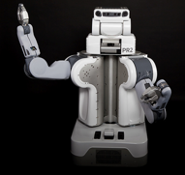
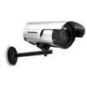
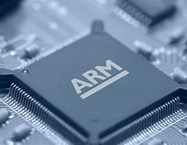
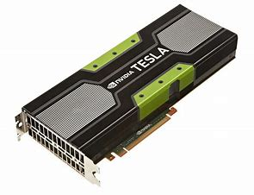
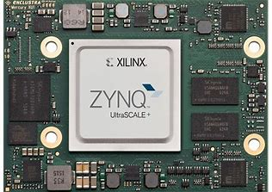
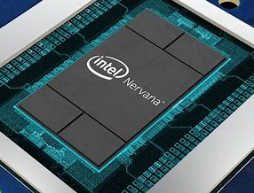
Embedded Computer Vision
Applications
Robots
Drones
Autonomous Vehicles
Security cameras
Mobile phones
CV Kernels/Tasks
Image Classification
Object Detection
Semantic Segmentation
Embedded
Platforms
CPU
GPU
FPGA
ASIC
Notes:
Nowadays, there are many diverse applications at the edge such as robotics, drones, autonomous vehicles, security camera and smart phones.
All these applications only rely on a few core CV kernels, such as image classification, object detection and semantic segmentation
This means if we optimize these kernels well, we can deploy all these applications efficiently on various embedded platforms, such as FPGAs.
TODO: Add animation, fpga is natural platform for imbedded device for its good power performance.
FPGA allows to do crazy designs.

Slide 4
Goals for Embedded CV
Accuracy
Efficiency
Essential metric for applications like security cameras and autonomous vehicles
Inference speed and power consumption constrain the deployment of CV tasks
Notes:
When we try to deploy the CV kernels on the embedded devices, we try to optimize for two keys goals.
First, accuracy.
Accuracy is a very essential metric for applications like security cameras and autonomous vehicles.
And second, efficiency, which is often thought as inference speed and power.
This is a metric that constrains the deployment scenarios of many applications.
TODO: Anime

Slide 5
How to improve accuracy and efficiency?
Design better ConvNet
Design better hardware
Notes:
Both the computer vision community and the hardware community are working towards the same goals.
However, we still see a gap between the two communities.

Slide 6
ConvNet Design
CV community has evolved ConvNets for good accuracy – efficiency has been less important
Efficiency proxies have been FLOPs and model size, ignoring hardware friendliness
VGG16[1] model:
Parameter size: 552 MB
Computation: 15.8 GOPs/image
NasNet[2] model:
Parameter size: 5.3 MB
Computation: 1.28 GOPs/image
[1] K. Simonyan and A. Zisserman. Very deep convolutional networks for large-scale image recognition. arXiv preprint arXiv:1409.1556, 2014.
[2] Zoph, B., Vasudevan, V., Shlens, J. and Le, Q.V. Learning Transferable Architectures for Scalable Image Recognition. arXiv e-prints. 1707-7012.
Notes:
On the algorithm side,
ConvNet designs have evolved to maximize accuracy
The CV community tends to pay secondary attention to the hardware efficiency.
Earlier network design such as the VGG Net, for example, requires 15.8 GOP to classify one image.
Nowadays even though the CV community starts to report total FLOPs and parameters size of their network design.
These efficiency proxies might not be the best measure for HW performance.
NasNet for example, has pretty small model size and low total ops, but if we take a look at its complicated structure, it is actually not easy to support it efficiently on the hardware.
While ignoring hardware efficiency
Ignoring hw friendliness and full mapping

Slide 7
Hardware Design
Most work only supports off-the-shelf network designs
Most effort has focused on reducing precision and on pruning
Often this throughput improvement comes at the expense of lower accuracy
Accuracy
Pareto optimal curve
Ideally
Accuracy drop
In practice
Efficiency
Notes:
The hardware community, on the other hand, tend to work on off-the-shelf network designs.
Few work attempted to change the NN structure to adapt them to hardware design.
Most of the work to-date have been focused on reducing the precision and pruning.
And often, improved throughput comes at the expense of lower accuracy.
Some previous work

Slide 8
Can we close this gap?
Design better ConvNet
Design better hardware
Notes:
So, I’ve explained the gap between the two communities.
Can we bridge this gap by synergizing the knowledge from both communities?
With this research, we hope to answer this by doing algorithm-hardware co-design to optimize for both accuracy and hardware efficiency

Slide 9
Outline
Introduction
ConvNet Design
Hardware Accelerator Design
Experimental Results
Conclusion
Notes:
First I will talk about how we designed efficient ConvNets for HW

Slide 10
ConvNet Design Strategies
Strategy 1: Use efficient models
Strategy 2: Simplify operators
Strategy 3: Quantize
Design better ConvNet
Notes:
We came up with three different design strategies: First, use efficient ConvNet Model, second, simplify the operator set and lastly we try to perform quantization the efficient network

Slide 11
CNN Strategy 1: Use efficient models
ShuffleNetV2-1.0x [1] as our starting point
Compared to VGG16:
65x fewer OPs
48x fewer parameters
Near equal accuracy on ImageNet
 | MACs | #Params | Top-1 Acc
ShuffleNetV2-1.0x | 146M | 2.3M | 69.4%
VGG16 | 15.3G | 138M | 71.5%
ShuffleNetV2 building blocks
[1] Ma, N., Zhang, X., Zheng, H. and Sun, J. {ShuffleNet V2: Practical Guidelines for Efficient CNN Architecture Design}. arXiv e-prints. 1807-11164.
Notes:
For strategy 1, we picked ShuffleNet V2 1x as our starting point.
Compared to VGG16, ShuffleNet V2 is an very efficient model
with 65x fewer operations and 48x fewer parameters.
But its accuracy is very close to VGG16. The figure on the left shows the basic builds blocks of shufflenetv2.
We see it is mainly composed of 1x1 conv and dw 3x3 conv instead of full 3x3 conv.
And it uses catcatention instead addition for the skip connection.
These are theirs trick to reduce the total computation by an order of magnitude.
So now we have an efficient hw to start with,
So we wonder if we can further improve this.

Slide 12
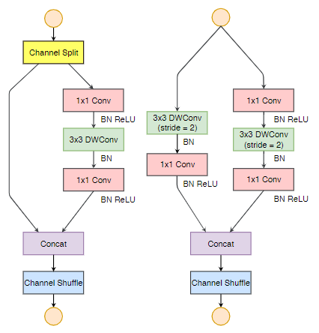
ShuffleNetV2
Macro-architecture
Building Block
[1] Ma, N., Zhang, X., Zheng, H. and Sun, J. {ShuffleNet V2: Practical Guidelines for Efficient CNN Architecture Design}. arXiv e-prints. 1807-11164.
Notes:
TODO:
Add macro architecture
Add micro architecture cells
What is not HW-friendly? Followed by our network design
Add anime of concat operations
Explain why additive skip connection is necessary?
Concat achieves similar func but more hw friendly

Slide 13
CNN Strategy 2: Simplify operators
Can we reduce the number of operator types?
Can we make the operation more hw-friendly?
Notes:
Here comes our second strategy. As we see from the pie chart, 90% of operations performed in ShuffleNet V2 are 1x1 conv. The other types of operators only take up 10% of the total ops. Since it is tricky to efficiently support all the operators and we don’t want to waste resources to support the operator that are barely used, so we wonder if we can reduce the types of operators? And if we can replace them with more hw friendly operators.

Slide 14
CNN Strategy 2: Simplify operators
Can we replace 3x3 convolutions?
Channel
Width
Height
Input tensor
Output tensor
Notes:
First, let’s look at 3x3 conv and 3x3 dw conv
Can we imagine a convolutional neural network without 3x3
It is a pretty crazy idea..right?
Let’s first examine what 3x3 convolution does.
For each 3x3 grid, the 3x3 convolution essentially aggregates the spatial info to the center.

Slide 15
The Shift Operation
The shift operation moves a neighboring pixel to the center position
Channel
Width
Height
Input tensor
Output tensor
[1] Wu, B., Wan, A., Yue, X., Jin, P., Zhao, S., Golmant, N., Gholaminejad, A., Gonzalez, J. and Keutzer, K. {Shift: A Zero FLOP, Zero Parameter Alternative to Spatial Convolutions}. arXiv e-prints. 1711-8141.
Notes:
If we think about it, the shift operation does the same thing without the need of any arithmetic operations.
From the shiftnet design, we learned that we can use shift to move the neighboring pixels at different channels to the center position.

Slide 16
The Shift Operation
1x1 conv aggregates spatial information along the channel dimension
Channel
Width
…
1x1 conv
Height
Input tensor
Output tensor
Notes:
Once we perform the shift operation, we can apply 1x1 conv to aggregate the spatial information along the channel dimension.

Slide 17
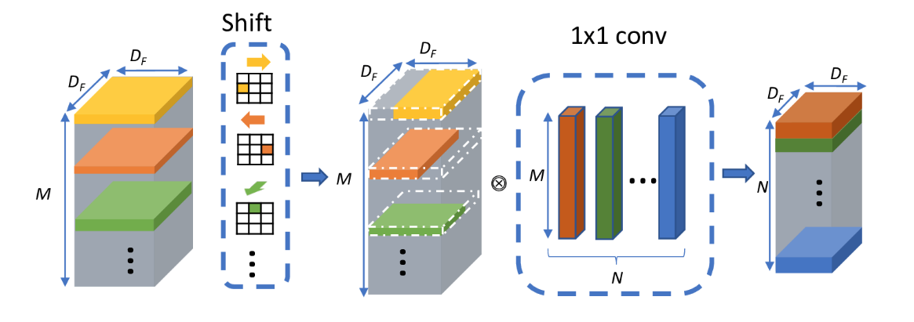
Replace 3 x 3 Conv
shift: Re-aligns pixels
1x1 conv: Mixes channel info
3x3 conv:
Aggregates neighboring pixels
Mixes channel info
Input tensor
Output tensor
Notes:
Again let’s recap what 3x3 conv does.
By combining the shift and 1x1 conv, it should achieve a similar functionality to full 3x3 conv. As the full 3x3 conv is essentially gathering the spatial information of a 3x3 field and aggregate the information across the channel dimension.

Slide 18
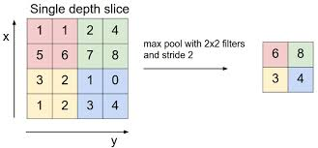
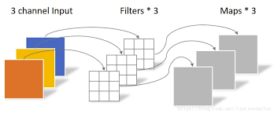
Replace 3 x 3 DW Conv
shift: Re-aligns pixels
2x2 pooling w/ stride 2: Downsamples
3x3 DW conv w/ stride 2:
Aggregates neighboring pixels
Downsamples
+
Notes:
Likewise, 3x3 dw is gathering the spatial information of a 3x3 grid and down-samples,
we can thus replace it with shift to realign pixels and 2x2 pooling with stride 2 to downsample

Slide 19
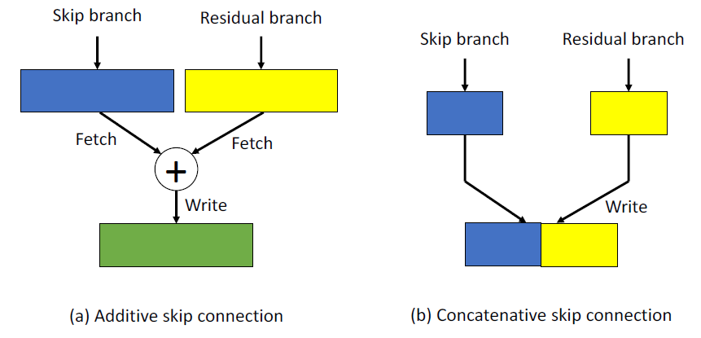
Strategy 2: Concatenative Connection
Concatenative skip connection
Achieve similar accuracy
Less CPU-FPGA data movement
Less on-chip synchronization and buffer
Quantization friendly
Notes:
We build our network DiracDeltaNet on the basis of ShuffleNet V2. I’ll explain how DiracDeltaNet fulfills the 4 properties of a hardware efficient ConvNet.
First, DiracDeltaNet inherits the hw friendly network structure from ShuffleNet V2.
It has identical blocks, which makes it easy to map the network compute on the FPGA.
DiracDeltaNet also uses the concatenative skip connections instead of the popular additive skip connectios in ResNet. Both topology has two branches of feature map, skip branch and residual branch. Skip branch is an identity mapping while the residual branch goes through a serious of convolution operations. Additive skip connections require a element wise addition between two branches. The residual branch is apparently slower than the skip branch, which means we need to use large fifos to buffer the data of the skip branch and extra synchronization between the two branches in order to compute an addition. While concatenative skip connections only concatenate the two branches and the value of the skip branch doesn’t change during the whole process. We can simply leave the data of the skip branch in DRAM and map the concatenation operation in DRAM rather than on FPGA. Thus, concatenative skip connection enables less CPU-FPGA data movement, less on-chip synchronization an buffer between the two branches. Also there is no need to worry about accumulation overflow in concatenative skip connection. Therefore, it’s also quantization friendly.
7.5min
Identical blocks: easy to schedule compute
DiracDeltaNet also uses the concatenative skip connections instead of the popular additive skip connectios in ResNet. The concatenative skip connection as illustrated in the right, concatenates the feature maps from two branches. The skip branch is an identity mapping while the residual branch goes through a serious of convolution operations. Since the concatenation doesn’t change the value of the skip branch, there is no need to map the concatenation operation on the FPGA. We can simply leave the data of the skip branch in DRAM. Only the residual branch needs to be fetched on chip. Thus, concatenative skip connection enables less CPU-FPGA data movement, less on-chip synchronization an buffer between the two branches. Also there is no need to worry about overflow in concatenative skip connection compared to additive connection. Therefor, it’s also quantization friendly.

Slide 20
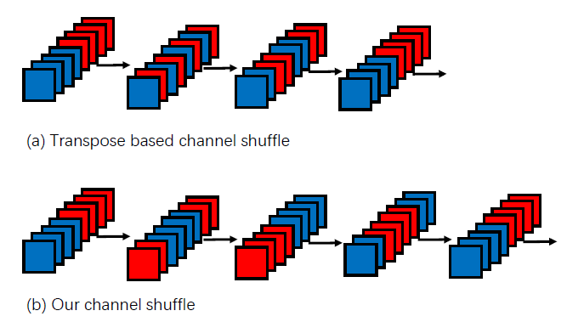
Strategy 2: Use hw-friendly operators
3x3 max-pooling -> 2x2 max-pooling
Hw-friendly channel shuffle
Notes:
Furthermore, we also change the transpose based channel shuffle in ShuffleNet V2 into the shift based shuffle, which has better locality. You can see that the red and blue feature map in transpose based shuffle is severely interleaved. While the blue feature maps in our method are just shifted along the channel dimension with better locality.
10min
TODO:
1. animation

Slide 21
Strategy 2: Use hw-friendly operators
3x3 max-pooling -> 2x2 max-pooling
Hw-friendly channel shuffle
Transpose based channel shuffle
Notes:
Furthermore, we also change the transpose based channel shuffle in ShuffleNet V2 into the shift based shuffle, which has better locality. You can see that the red and blue feature map in transpose based shuffle is severely interleaved. While the blue feature maps in our method are just shifted along the channel dimension with better locality.
10min
TODO:
1. animation

Slide 22
Strategy 2: Use hw-friendly operators
3x3 max-pooling -> 2x2 max-pooling
Hw-friendly channel shuffle
Transpose based channel shuffle
Notes:
Furthermore, we also change the transpose based channel shuffle in ShuffleNet V2 into the shift based shuffle, which has better locality. You can see that the red and blue feature map in transpose based shuffle is severely interleaved. While the blue feature maps in our method are just shifted along the channel dimension with better locality.
10min
TODO:
1. animation

Slide 23
Strategy 2: Use hw-friendly operators
3x3 max-pooling -> 2x2 max-pooling
Hw-friendly channel shuffle
Our channel shuffle
Notes:
Furthermore, we also change the transpose based channel shuffle in ShuffleNet V2 into the shift based shuffle, which has better locality. You can see that the red and blue feature map in transpose based shuffle is severely interleaved. While the blue feature maps in our method are just shifted along the channel dimension with better locality.
10min
TODO:
1. animation

Slide 24
Strategy 2: Use hw-friendly operators
3x3 max-pooling -> 2x2 max-pooling
Hw-friendly channel shuffle
Our channel shuffle
Notes:
Furthermore, we also change the transpose based channel shuffle in ShuffleNet V2 into the shift based shuffle, which has better locality. You can see that the red and blue feature map in transpose based shuffle is severely interleaved. While the blue feature maps in our method are just shifted along the channel dimension with better locality.
10min
TODO:
1. animation

Slide 25
Strategy 2: Use hw-friendly operators
3x3 max-pooling -> 2x2 max-pooling
Hw-friendly channel shuffle
Our channel shuffle
Notes:
Furthermore, we also change the transpose based channel shuffle in ShuffleNet V2 into the shift based shuffle, which has better locality. You can see that the red and blue feature map in transpose based shuffle is severely interleaved. While the blue feature maps in our method are just shifted along the channel dimension with better locality.
10min
TODO:
1. animation

Slide 26
Strategy 2: Use hw-friendly operators
3x3 max-pooling -> 2x2 max-pooling
Hw-friendly channel shuffle
Our channel shuffle
Notes:
Furthermore, we also change the transpose based channel shuffle in ShuffleNet V2 into the shift based shuffle, which has better locality. You can see that the red and blue feature map in transpose based shuffle is severely interleaved. While the blue feature maps in our method are just shifted along the channel dimension with better locality.
10min
TODO:
1. animation

Slide 27
Strategy 2: Use hw-friendly operators
3x3 max-pooling -> 2x2 max-pooling
Hw-friendly channel shuffle
Our channel shuffle
Notes:
Furthermore, we also change the transpose based channel shuffle in ShuffleNet V2 into the shift based shuffle, which has better locality. You can see that the red and blue feature map in transpose based shuffle is severely interleaved. While the blue feature maps in our method are just shifted along the channel dimension with better locality.
10min
TODO:
1. animation

Slide 28
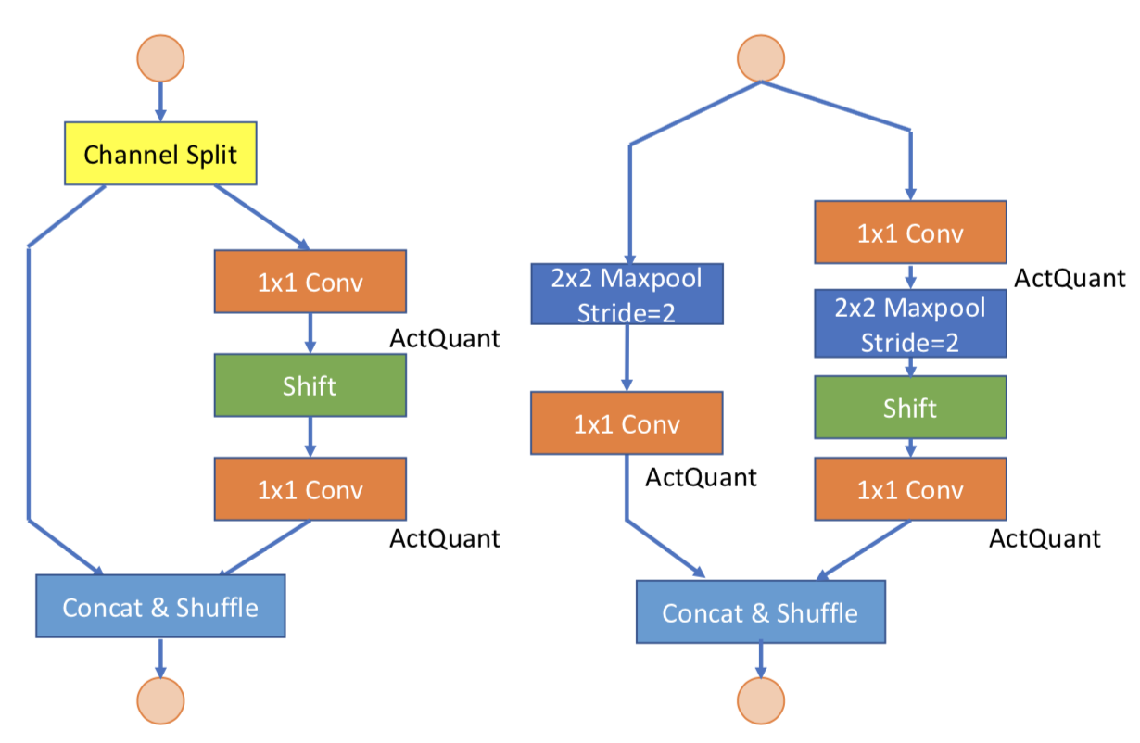
ShuffleNetV2 -> DiracDeltaNet
Accuracy (full precision): 69.4%
Operators involved:
1x1 convolution
3x3 convolution
3x3 DW convolution
3x3 max pooling
Channel split/shuffle/concat
Accuracy (full precision): 69.7%
Operators involved:
1x1 convolution
2x2 max pooling
Channel split/shuffle/shift/concat
[1] Ma, Ningning, et al. "ShuffleNet V2: Practical Guidelines for Efficient CNN Architecture Design." arXiv preprint arXiv:1807.11164 (2018).
Notes:
Here is how our DiracdeltaNet building block looks like compared to the ShuffleNetV2 design. At full precision, we can achieve higher accuracy with less operators to support.
We call it DiracdeltaNet because it only contains 1x1 conv

Slide 29
CNN Strategy 3: Quantize
Quantization has been mostly demonstrated on large networks. Is it effective on the small ones like DiracDeltaNet?
We used existing quantization methods:
DoReFaNet [1] method for weights
Modified PACT [2] method for activations
We achieved 4-bit weight and 4-bit activation precision with competitive accuracy
 | Network | Pruning | Precision | Top-1 Acc
[3] | VGG16 | Yes | 8-8b | 67.72%
Ours | DiracDeltaNet | No | 4-4b | 67.52%
[1] Zhou, S., Wu, Y., Ni, Z., Zhou, X., Wen, H. and Zou, Y. {DoReFa-Net: Training Low Bitwidth Convolutional Neural Networks with Low Bitwidth Gradients}. arXiv e-prints. 1606-6160.
[2] Choi, J., Wang, Z., Venkataramani, S., I-Jen Chuang, P., Srinivasan, V. and Gopalakrishnan, K.PACT: Parameterized Clipping Activation for Quantized Neural Networks.
[3] Guo, K., Han, S., Yao, S., Wang, Y., Xie, Y. and Yang, H. Software-Hardware Codesign for Efficient Neural Network Acceleration. IEEE Micro
Notes:
Previous work demonstrated on large model vgg and resnet, for smaller network can we do the same thing
Whether they are still effective?
The last strategy we explore is to quantize the network. We use existing methods with progressive strategy and fine tuning after each quantization to recover accuracy. We managed to quantize the full precision model to 4-bit weights and 4 bit activations with less than X% top-5 accuracy loss.
We didn’t do pruning, introduces sparsity
Quantization-friendly network structure:
Replaces addition with concatenation for the skip connection
Avoids overflow problem

Slide 30
Outline
Introduction
ConvNet Design
Hardware Accelerator Design
Experimental Results
Conclusion
Notes:
Next we are going to talk about our hw design

Slide 31
Can we close this gap?
Design better ConvNet
Design better hardware
Notes:
Now we have addressed one-side of the gap, now we will focus on the hardware for conv design

Slide 32
Hardware Design Strategies
Strategy 1: Specialize conv engine
Strategy 2: Use dataflow architecture
Strategy 3: Merge layers
Design better hardware
Notes:
We also had up with 3 different design strategies for hw design

Slide 33
HW Strategy 1: Specialize conv engine
1x1 Conv Unit:
Supports matrix-vector multiplication
4-bit inputs
4-bit weights
17-bit partial sums
Buffers weights and partial sums on-chip
Performs 32 x 32 MACs per iteration
Each input gets reused output channel size times
33
Notes:
Strategy 1 is to specialize hw support for 1x1 conv
Since it is the only type of conv we need to support, it is essentially a matrix vector multiplication engine.
This engine takes 4-bit input and produces 17-bit partial sums. We buffer the weights of an entire layer and the parital sums on-chip. The engine can perform 32x32 MACs per iteration. Each input pixel gets reused output channel size times after it is fetched.
With the specialized compute engine, we can simply controlling logic for scheduling and use the on-chip resources more effectively.

Slide 34
Strategy 2: Use dataflow architecture
1x1 conv
No line-buffer
shift
3x3 sliding window, II=1
2x2 max-pooling
2x2 sliding window, II=2
2x2 max-pooling example:
4 | 2 | 5 | 6 | 9
1 | 3 | 8 | 7 | 3
6 | 4 | 2 | 8 | 1
Notes:
The 2nd strategy is to use dataflow architecture with line buffers to exploit the pipeline parallelism.
We lay the data out so the input channel dimension is the lowest dimension.
For shift and 2x2 pooling that require spatial info, we need to have a line buffer to store the intermediate outputs. Once the line buffer is initialized, the shift can produce one output per 1 cycle and the 2x2 pooling with stride 2 can produce one output per 2 cycles. The anime shows how max-pooling works. So we just slide the 2x2 window on the line buffer and take the max from the window

Slide 35
Strategy 2: Use dataflow architecture
1x1 conv
No line-buffer
shift
3x3 sliding window, II=1
2x2 max-pooling
2x2 sliding window, II=2
2x2 max-pooling example:
4 | 2 | 5 | 6 | 9
1 | 3 | 8 | 7 | 3
6 | 4 | 2 | 8 | 1
4
Notes:
The 2nd strategy is to use dataflow architecture with line buffers to exploit the pipeline parallelism. We lay the data out so the input channel dimension is the lowest dimension.
For shift and 2x2 conv that require spatial info, we need to have a line buffer to store the intermediate outputs. Once the line buffer is initialized, the shift can produce one per 1 cycle and the 2x2 pooling with stride 2 can produce one output per 2 cycles. The anime shows how max-pooling works. So we just slide the 2x2 window on the line buffer and take the max from the window

Slide 36
Strategy 2: Use dataflow architecture
1x1 conv
No line-buffer
shift
3x3 sliding window, II=1
2x2 max-pooling
2x2 sliding window, II=2
2x2 max-pooling example:
4 | 2 | 5 | 6 | 9
1 | 3 | 8 | 7 | 3
6 | 4 | 2 | 8 | 1
4

Slide 37
Strategy 2: Use dataflow architecture
1x1 conv
No line-buffer
shift
3x3 sliding window, II=1
2x2 max-pooling
2x2 sliding window, II=2
2x2 max-pooling example:
4 | 2 | 5 | 6 | 9
1 | 3 | 8 | 7 | 3
6 | 4 | 2 | 8 | 1
4

Slide 38
Strategy 2: Use dataflow architecture
1x1 conv
No line-buffer
shift
3x3 sliding window, II=1
2x2 max-pooling
2x2 sliding window, II=2
2x2 max-pooling example:
4 | 2 | 5 | 6 | 9
1 | 3 | 8 | 7 | 3
6 | 4 | 2 | 8 | 1
4 | 8

Slide 39
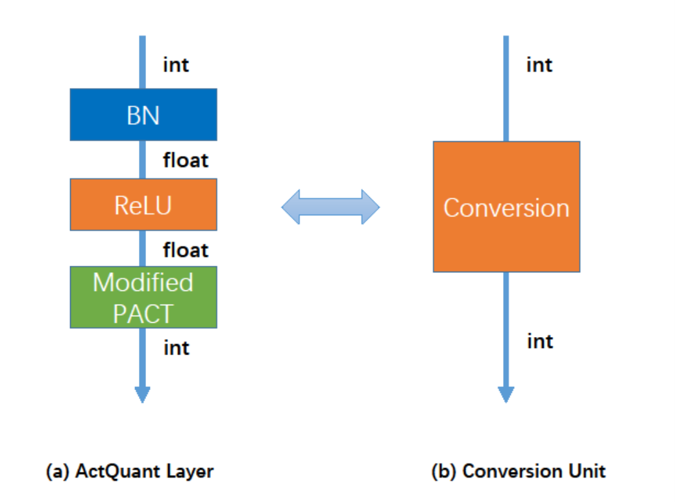
Strategy 3: Merge layers
Conversion unit includes:
Batch Norm
ReLU
Modified PACT
It performs 17-bit to 4-bit conversion
It is implemented with comparators
17-bit partial sum
17-bit partial sum
4-bit activation
4-bit activation
39
Notes:
The last strategy is to merge layers.
Adding the quantization does not make the hw design more complicated as we can essentially merge BN/ReLU and the quantization layers into a conversion module. The conversion unit takes a 17-bits partial sum and turn it into a 4-bit value.
Since the 3 functions in conversion unit are monotonic, we can easily implement the HW using comparators with 15 threshold values.

Slide 40
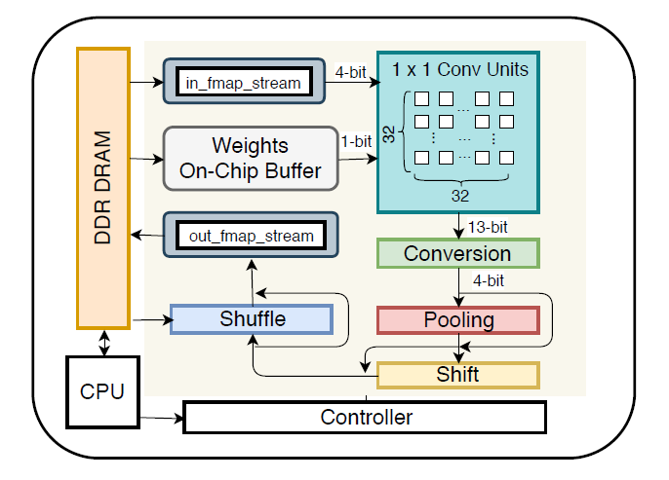
Synetgy Architecture Overview
HW engine supports:
1x1 conv
2x2 max-pooling
shift
shuffle
Layer-based design
Implemented with Vivado HLS and PYNQ
Notes:
This slide shows an overall architecture of the synetgy hardware.
At every invocation of the accelerator, it can compute one subgraph of 1x1 conv, 2x2 max pooling, following by shift and shuffle operations.
We implemented the accelerator in Vivado HLS and the PYNQ tools.

Slide 41
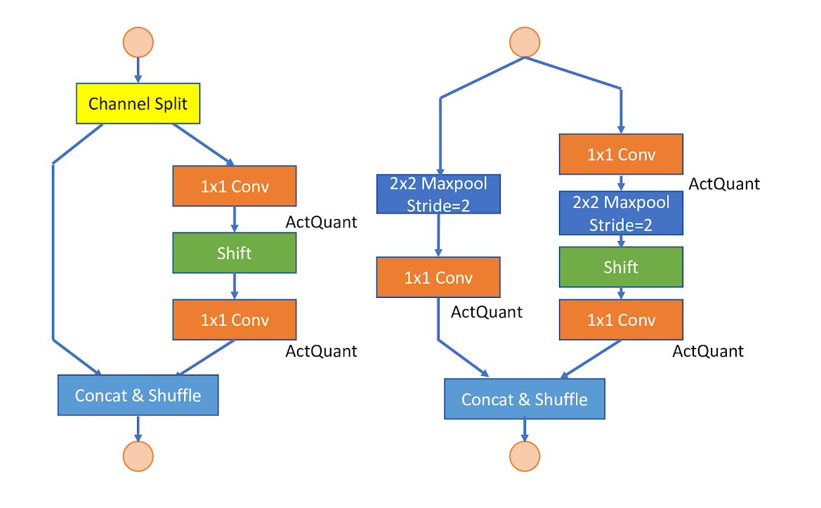
Execution Model
DiracDeltaNet Block
Notes:
The following slides show how we schedule the building blocks of DiractDeltaNetV2 onto the accelerator. Basically, every call to the accelerator compute a subgraph of the network that has exactly one 1x1 conv.

Slide 42
Execution Model
1
DiracDeltaNet Block
Notes:
TODO:
Add sw -> hw mapping
Add animation on the hw + skips

Slide 43
Execution Model
1
2
DiracDeltaNet Block
Notes:
TODO:
Add sw -> hw mapping
Add animation on the hw + skips

Slide 44
Execution Model
1
1
2
DiracDeltaNet Block
Notes:
TODO:
Add sw -> hw mapping
Add animation on the hw + skips

Slide 45
Execution Model
1
1
2
2
DiracDeltaNet Block
Notes:
TODO:
Add sw -> hw mapping
Add animation on the hw + skips

Slide 46
Execution Model
1
1
2
2
3
DiracDeltaNet Block
Notes:
TODO:
Add sw -> hw mapping
Add animation on the hw + skips

Slide 47
Outline
Introduction
ConvNet Design
Hardware Accelerator Design
Experimental Results
Conclusion
Notes:
Here comes our experimental results. As we found a bug in python implementation, you might notice some results change from the paper.

Slide 48
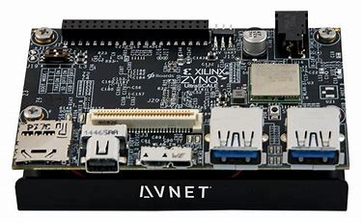
Experimental Setup
Avnet Ultra96 Board
With Xilinx ZU3EG FPGA – the second smallest device in the Ultrascale+ family
5.4 cm
8.5 cm
Notes:
We run the accelerator on the Ultra96 board with a Xilinx ZU3EG FPGA, which is the second smallest device in the ultrascale+ family

Slide 49
Resource Usage
LUT | FF | BRAM | DSP
51776(73.4%) | 42257(29.9%) | 159(73.6%) | 360(100%)
LUT: 4/4bit multiplications (1x1 conv)
FF: fully-partitioned partial sums (1x1 conv)
BRAM: line buffers and FIFOs (dataflow)
DSP: 4/4bit multiplications (1x1conv)
On-chip Layout
Notes:
Here shows the resource utilization of our accelerator. Most of the LUTs/DSP are used for computing 4-bit multiplication. The BRAM is used for line buffers and fifos.

Slide 50
Comparison with Previous Work
 | Platform | Framerate | Top-1 Acc | Precision | Energy/ Frame (J)
[1] | Zynq 7Z020 | 5.7 | 67.72% | 8-8b | 0.526
[2] | Zynq 7Z045 | 4.5 | 64.64% | 16-16b | 0.666
[3] | Stratix-V | 3.8 | 66.58% | 8-16b | 5.026
Ours | Zynq ZU3EG | 66.3 | 67.52% | 4-4b | 0.083
Equal top-1 accuracy
11.6x higher framerate
6.3x more power efficient
[1] Guo, K., Han, S., Yao, S., Wang, Y., Xie, Y. and Yang, H. Software-Hardware Codesign for Efficient Neural Network Acceleration. IEEE Micro, 37 (2). 18-25.
[2] Qiu, J., Wang, J., Yao, S., Guo, K., Li, B., Zhou, E., Yu, J., Tang, T., Xu, N., Song, S., Wang, Y. and Yang, H. Going Deeper with Embedded {FPGA} Platform for Convolutional Neural Network, 2016, 26-35.
[3] Suda, N., Chandra, V., Dasika, G., Mohanty, A., Ma, Y., Vrudhula, S.B.K., Seo, J.S. and Cao, Y. Throughput-Optimized OpenCL-based {FPGA} Accelerator for Large-Scale Convolutional Neural Networks, 2016, 16-25.

Slide 51
Batch Size
Mitigate software API call (Python) overhead
Accelerator runtime (batch=1) 0.15ms
API call 0.40ms
More activation and weight reuse leads to better performance
Batch Size | 1 | 2 | 4 | 8 | 16
Framerate (fps) | 41.4 | 53.6 | 62.6 | 65.6 | 66.3
Notes:
We batch multiple image together mainly to average out the overhead incurred by the software API call to the accelerator. The latency of python API call is actually larger than the computational latency of a layer. We reduce the times of API call by batching. Also batching enables more weight reuse. With batching, the frame rate can go from 58.7 on batch 1 all the way up to 96.5 on a batch of 16.
16.5min
TODO:
Justify 16 -> Multiple cameras

Slide 52
Outline
Introduction
ConvNet Design
Hardware Accelerator Design
Experimental Results
Conclusion
Notes:
I’ll first give the introduction.
Maybe give a motivating summary instead

Slide 53
Can we perform co-design to close this gap?
Algorithm-hardware co-design can achieve both high accuracy (67.5% top-1) and good efficiency (66 FPS) for embedded CV applications
Design better ConvNet
Design better hardware
Notes:
From this work, we show that by codesigining hw and algorithm we can close the gap.
The codesign methodology can achieve high accuracy

Slide 54
Future Work
Automate the co-design process
More comprehensive deep neural network search
More comprehensive HW design space exploration
Algorithm
Hardware
Notes:
In this work, we demonstrate that algorithm-hardware co-design can achieve both high accuracy and fast inference for embedded CV applications. For future work, we will further increase the parallelism of the accelerator and modify DiracDeltaNet’s structure to be more regular.
18.5min

Slide 55
Thank you!
Q&A
Notes:
20min

Slide 56
Backup Slides

